Slide 1


SAP UI5 & FIORI with OData TRAINING
Anubhav Oberoy & Nishan Nainsukha
Day – 11

Slide 2

Agenda – Day 11
Master Detail Application
Master Detail Page
Object Header in SAPUI5
Icon tab bar in SAP UI5
Routes and Routing
Routing Configuration
Navigation and Routing
Concept of Enable Routing

Slide 3
Master Detail Application
The SAPUI5 Master-Detail Worklist Application template implements a typical split-screen layout, one of the design patterns that is specified by the SAP Fiori Design Guidelines.
The split-screen layout is optimized for displaying and processing a list of items. On the left side of the screen, users can quickly scan and navigate through the list. On the right side, they then see the details of the selected item, and can trigger related actions or edit the data.
The main control of this app is the sap.m.SplitApp control that displays the Master view with a list of objects on the left side and the Detail view on the right side. When the user presses an object in the master list, the detail page is updated with the context of the selected item.
The Master view shows the current number of items and a search field that can be used to search through the list items. The number of items are updated automatically and the search filters for a preconfigured field of the list.
The Detail page contains a simple object header displaying more details for the selected object, an empty sap.m.IconTabBar that can be enriched with custom app content, and a table of line items that are associated to the selected object in the data model.
Trainer: Anubhav Oberoy & Nishan

Slide 6
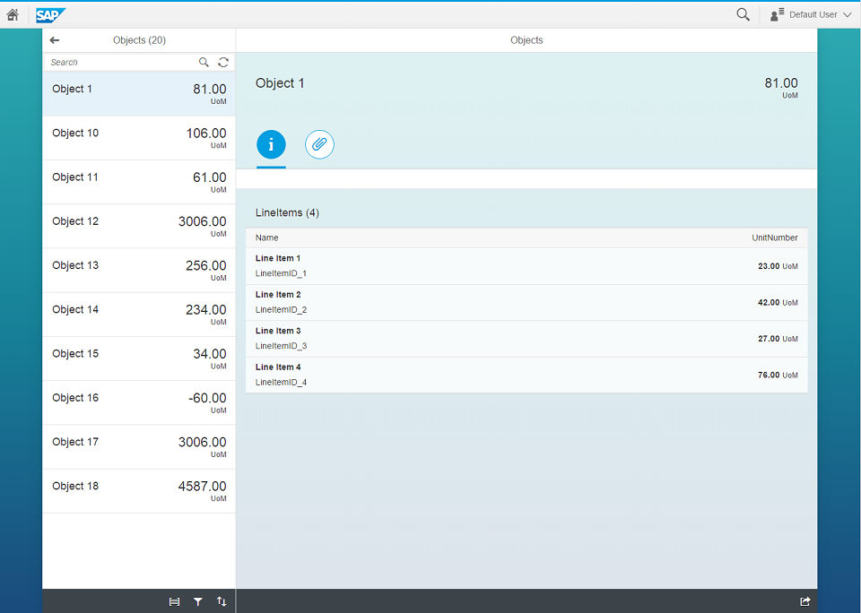
Master Detail Page
App View
App Container
View 1
View 2
View 2

Slide 7


Object Header
ObjectHeader is a display control that enables the user to easily identify a specific object.
The object header title is the key identifier of the object and additional text and icons can be used to further distinguish it from other objects.
Exercise 1:
In this exercise we will add ObjectHeader in View2
View1.view.xml
View2.view.xml
View1.controller.js
View2.controller.js
BaseController.js
App.view.xml
App.controller.js
Manifest.json
Component.js
Formatter.js
Trainer: Anubhav Oberoy & Nishan

Slide 8
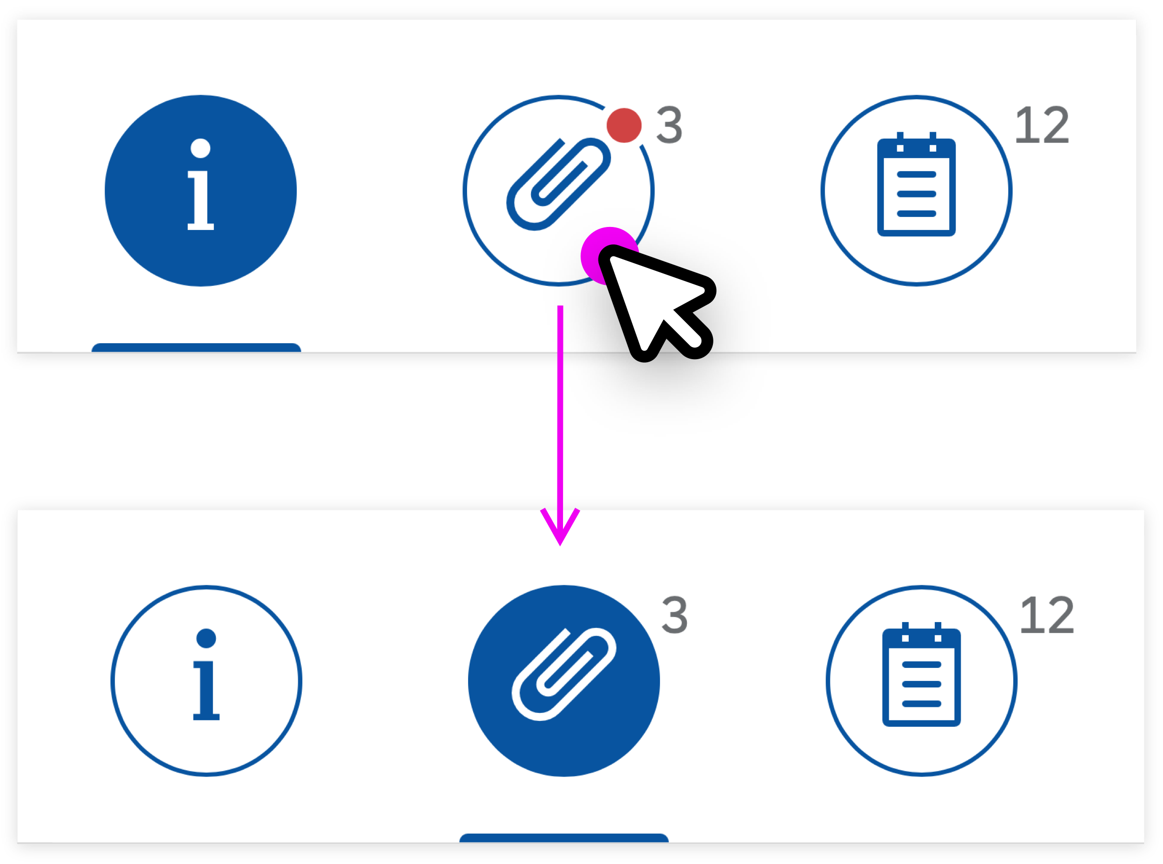
IconTab Bar
The IconTabBar represents a collection of tabs with associated content.
The IconTabFilter holds all information on an item - text, icon and count.
The IconTabBar can be used for navigation within an object, or as a filter. Different types of IconTabBar are used based on the contents.
Filter - There is only one main content for all tabs. The main content can be filtered, based on the selected tab.
Normal tab bar - The contents of each tab are independent from each other.
Combination of the above - There can be both filtered and independent contents.
Exercise 2:
In this exercise we will add IconTabBar and Footer section in View2
View2.view.xml
View2.controller.js
Trainer: Anubhav Oberoy & Nishan

Slide 9

Problem in our Fiori Like App - Navigation
When we press browser back and forward button, they should work correctly. Basically the back button should load the immediate back step just before navigation.
When a internet failure happens, before that we were at a particular state of the app and when app comes back online or refresh happens the app starts all over again, this will be annoying to user.
When we copy URL of our app and give it to someone, we were at a deeper navigation of an app. When we give the URL to them, it should reload the state of the application. Like AMAZON, FB PROFILE.
Instantiating view at the beginning is a high cost of memory consumption. When we go to a particular screen only then we need to create view object.
There is no standard followed to create view objects, each developer may write view codes inside different files eventually making is hard for fellow developers/successors to maintain the software.
The function to create view object sap.ui.view is deprecated.
www.anubhavtrainings.com

Slide 10

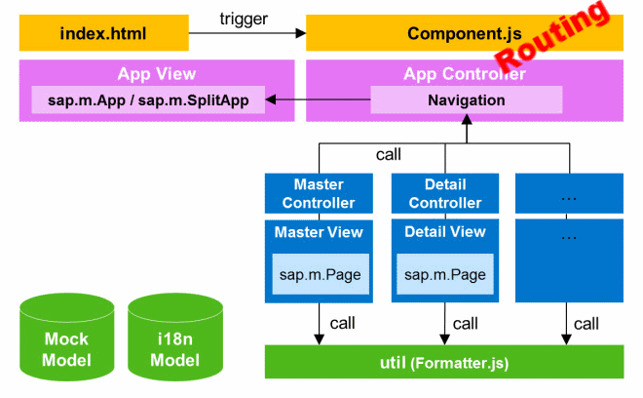
Routes and Routing
Router: Router is the class used for Routing and Navigation purpose in SAP UI5 framework.
Routing: routing configurations in manifest.json file which is also called descriptor file. Routing is defined using routing namespace within sap.ui5 namespace.
Trainer: Anubhav Oberoy & Nishan

Slide 11
Routing Configuration
Routing configuration consists of routes, targets, config, and owner.
config
routes
targets
This section contains the global router configuration and default values that apply for all routes and targets. We define the router class that we want to use and where our views are located in the app.
Each route defines a name, a pattern, and one or more targets to navigate to when the route has been hit.
Three subsections :-
1. pattern
2. name
3. target
A target defines a view that is or more routes displayed, it is associated with one.
Subsections: -
Overview
detail
Trainer: Anubhav Oberoy & Nishan

Slide 12
Navigation and Routing
Navigation and routing is essential in modern single-page applications such as apps built with SAPUI5.
In classical web applications, the server determines which resource is requested based on the URL pattern of the request and serves it accordingly. The server-side logic controls how the requested resource or page is displayed in an appropriate way.
In single-page applications, only one page is initially requested from the server and additional resources are dynamically loaded using client-side logic. The user only navigates within this page. The navigation is persisted in the hash instead of the server path or URL parameters.
Sap.m.routing.Router is the class used for Routing and Navigation purpose in SAP UI5 framework.
“Pattern” defines the hashtag that needs to be added at the end of the URL when it is hit.
“name” defines a unique name for the particular route.
“target” defines the target which is defined in targets section
Trainer: Anubhav Oberoy & Nishan

Slide 13

Exercise 3
Design a SAP Fiori Master-Detail Application With routing and understand the concept of Route Match Handler
View1.Controller.js
View2.Controller.js
Add new controller as Avengers.Controller.js which has image
Avengers.view.xml
Update component.js file
Add routing in manifest.json file
Trainer: Anubhav Oberoy & Nishan

Slide 14
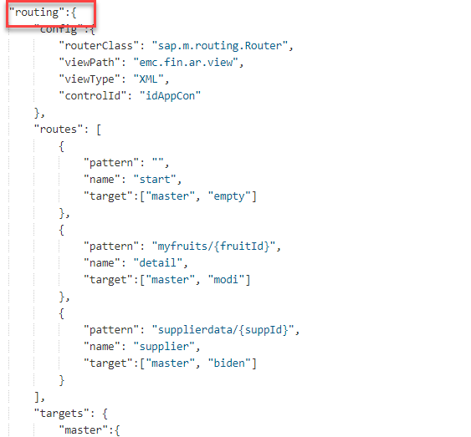
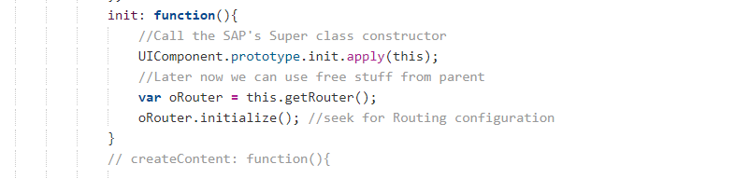
Concept of enable routing
The routing configuration controls the application flow when the user triggers a navigation action or opens a link to the application directly.
https://sapui5.hana.ondemand.com/#/topic/1b6dcd39a6a74f528b27ddb22f15af0d
manifest file has the routing as given below diagram
Routing in Component.js
Trainer: Anubhav Oberoy & Nishan

Slide 15

End of Day 11

Slide 16

Any Questions ?

Slide 17

Anubhav Oberoy

Slide 18
Title
Content

